Slide 1
Classification of Epileptoid Oscillations in EEG using Shannon’s Entropy Amplitude Probability Distribution
Ronald Broberg and Rory Lewis
Department of Mathematics. University of Colorado at Colorado Springs and Department of Computer Science, University of Colorado at Colorado Springs.

Slide 2
Outline
The Challenge
Amplitude Entropy
Exploration
Experiment
Results

Slide 3

EEG Channels
http://recherche.parisdescartes.fr/LaboratoireMemoireCognition_esl/Moyens-Techniques/EEG-Platform
http://recherche.parisdescartes.fr/var/kitbasic/storage/images/media/images/laboratoire-memoire-et-cognition/eeg/20312-1-fre-FR/EEG_large.jpg

Slide 4
Epileptic Seizures in EEG recordings
Categories
Interictal
Preictal
Ictal (seizure)
Postictal
Classification
Detection
Machine labeling
Prediction
Intervention
Feature Selection
Univariate
Bivariate
Multivariate

Slide 5
Public Data Sets
1990s – mid-2000s
Caltech
Andrezak, University of Bonn
5 classes, 100 files, 246 Hz, 23 second
Mid-2000s
Freiburg
Mid-2000s – Present
Physionet
Childrens’ Hospital Boston / MIT (CHBMIT)
University of Pennsylvania

Slide 6
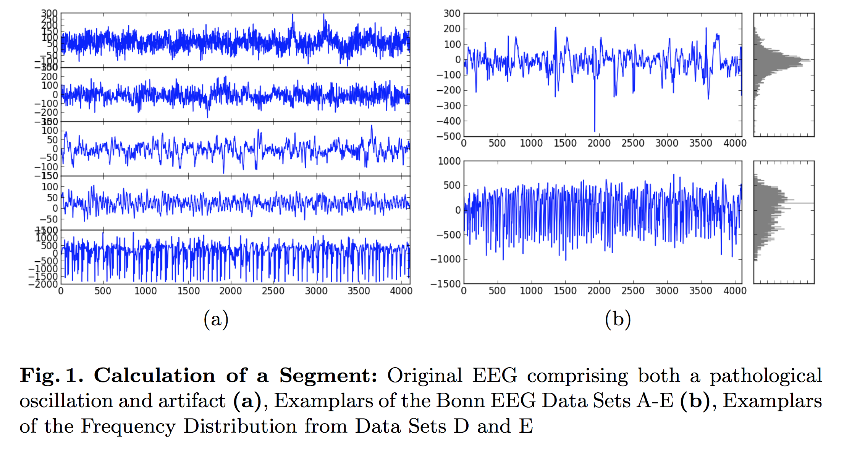
Entropy of Amplitude

Slide 7

Entropy of Amplitude

Slide 8
Explorations

Slide 9
Entropy of Amplitude

Slide 10
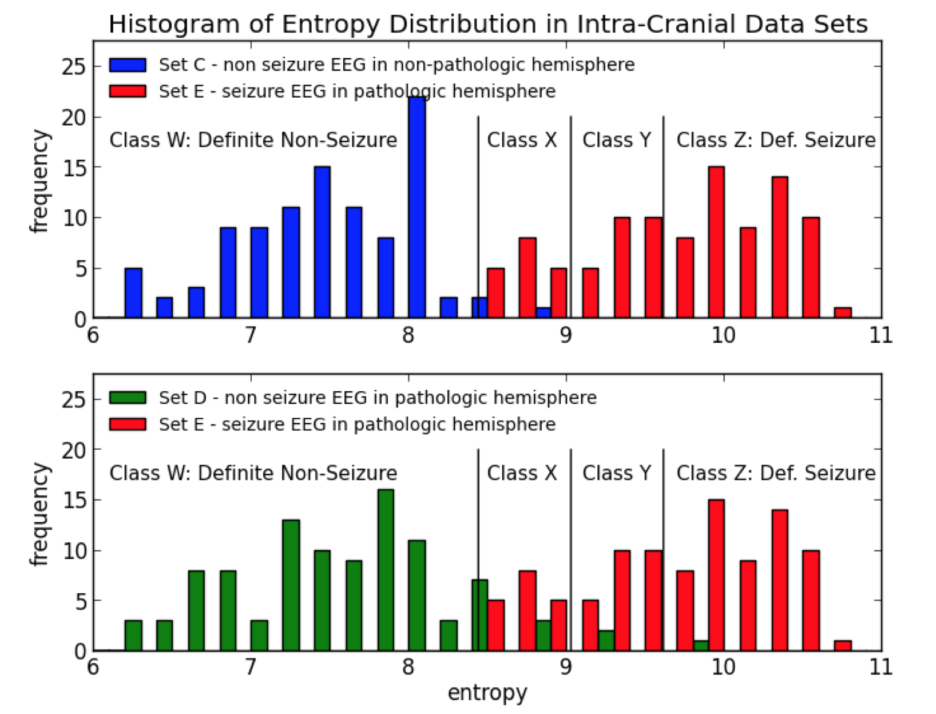
Classification by Amplitude Entropy

Slide 11
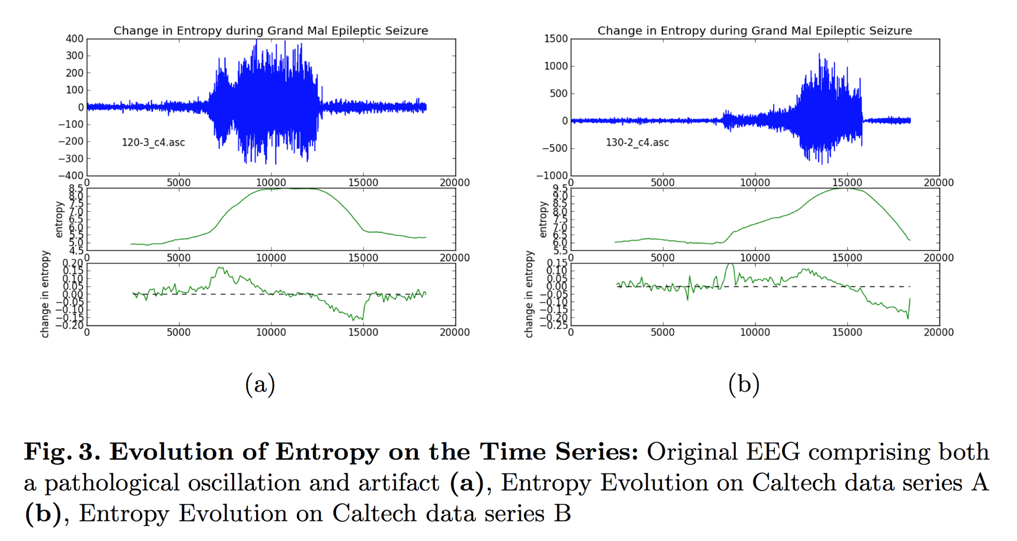
Entropy over Time

Slide 12
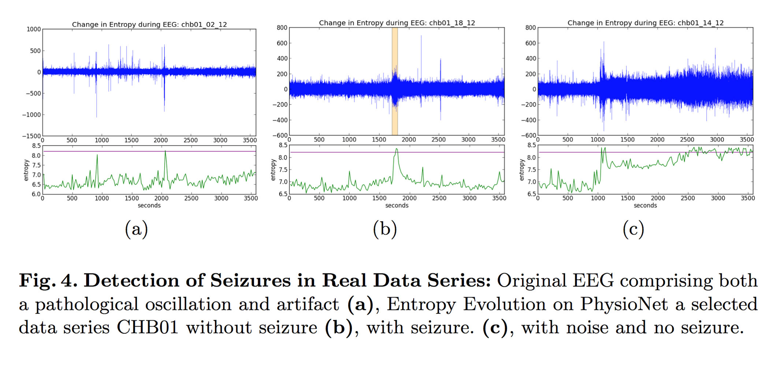
Amp Entropy in CHB/MIT

Slide 13
Results

Slide 14
Experiment: Kaggle Challenge
University of Pennsylvania
Detect Seizure
4 Canine @ 400Hz / 8 Human @ 5000Hz
~ 100 GiB data
0.95810 AUC with Random Forest Classification
Univariate, Bivariate, and Multivariate Features.
Time Domain and Frequency Domain
0.00000 AUC extended with Amp Entropy

Slide 15
Questions

